Slide 1
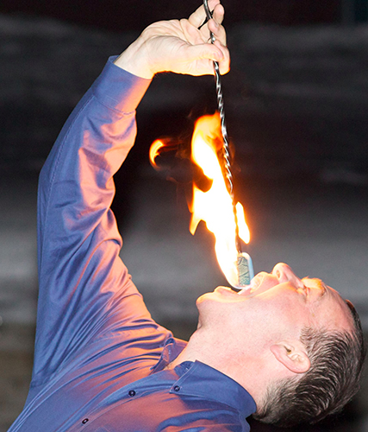

Slide 2
1
5
3
2
4
head

Slide 3
5
3
1
2
4
head

Slide 4
1
9
5
3
7
head

Slide 5
Step 1: Find 5
1
9
5
3
7
head

Slide 6
Step 2: Remove 5
1
9
3
7
head

Slide 7
1
2
3
4
5
head

Slide 8
1
5
3
2
4
head

Slide 9
1
9
3
7
head

Slide 10
1
9
3
7
head

Slide 11
1
9
5
3
7
head

Slide 12
